Slide 1
Career Development Training Course
Enlisted Assignment System

Slide 2
Enabling Objectives
LIST purposes of the Enlisted Assignment System.
DISCUSS the types of duty in the Enlisted Assignment System.
DESCRIBE the differences between Detailers (BUPERS 40X) and Placement (BUPERS-4013).
DISCUSS how assignment incentives contribute to the Enlisted Assignment System.
DEFINE Projected Rotation Date (PRD), Time-On-Station (TOS) and Obligated Service (OBLISERV).
DESCRIBE the process to match Service Member’s needs with their duty preferences.
LIST the process to complete an Electronic Personnel Action Request (ePAR 1306/7).
Notes:
FACILITATORS GUIDE:
Review objectives.

Slide 3
References
Navy Military Personnel Manual, NAVPERS 15560 (series)
MILPERSMAN 1306-141, Voluntary Sea Duty Program
MILPERSMAN 1300-1000, Military Couple and Single Parent Assignment Policy
MILPERSMAN 1300-500, Reassignment for Humanitarian Reasons
MILPERMAN 1306-106, Time on Station (TOS) and Retainability Obligated Service (OBLISERV)
MILPERSMAN 1306-104, Projected Rotation Date (PRD)
MILPERSMAN 1306-700, Exchanges of Duty (SWAPS)
Notes:
FACILITATOR GUIDE:
Review references.

Slide 4
References
NAVADMIN 017/24, Detailing Marketplace Assignment Policy Phase IV
NAVADMIN 109/23, Detailing Marketplace Assignment Policy Phase III
NAVADMIN 228/22, Detailing Marketplace Assignment Policy Phase II
NAVADMIN 127/22, Detailing Marketplace Assignment Policy Phase I Update
NAVADMIN 280/21, Detailing Marketplace Assignment Policy
NAVADMIN 172/22, Active Duty Enlisted Advance-to-Position Program Update
MyNavy Assignment
  MNA-CMD/CCC interactive Guide
  NAVADMIN 276/19
Assignment Incentive Pay (AIP) Program, CNO Policy Decision Memo 003-06
Notes:
FACILITATOR GUIDE:
Review references.

Slide 5
Purpose of the Enlisted Assignment System
System for distribution of enlisted personnel.
Places the right person in the right job with the right skills at the right time.
Promotes maximum readiness afloat and ashore.
Permits equal opportunity for personnel to serve in duty they consider desirable.
Notes:
FACILITATOR GUIDE:
Discuss how the Navy’s manning affects advancement and readiness
Discuss that MNA is designed to provide the Navy with the right person in the billets.

Slide 6
Common Terms
PRD, TOS, and OBLISERV
Projected Rotation Date (PRD) – established when orders are written based off prescribed sea time (PST) and Sea/Shore flow.
  MPM 1306-104
Time-On- Station (TOS) – period served in same geographical area.
  MPM 1306-106
Obligated Service Requirements (OBLISERV) – minimum amount of active service Sailors must agree to before executing a PCS transfer.
  MPM 1306-106
Notes:
FACILITATOR GUIDE:
Example of common terms used during the assignment process.

Slide 7
Distribution Management Controls
To support assignment of enlisted personnel and readiness of activities, three distinct and separate functions of enlisted distribution management controls were established:
    Allocation Control
    Manning Control
    Assignment Control
Notes:
FACILITATOR GUIDE:
Allocation Control - governs Placement Coordinator and Rating Specialist Leads
· Manning Control - Fleet Commander (Fleet forces command or Pacific Fleet) Each TYCOM will supply their manning needs to them.
· Assignment Control –Detailer
· Utilize the command’s Activity Manning Manager (AMM)
*If you have assumed the role as AMM utilize the User Guides form the Help tab in MNA for all roles*
· AMMs are the Commands advocate to sustain a fully manned and ready crew.
· AMMs can project gapped billets and request them to be filled by contacting the Placement coordinator or Fleet Commander.

Slide 8
Allocation Control
The function of allocating available personnel resources to the two manning control authorities:
  Manning Control Authority Fleet (MCAF)
    All Sea and Fleet operational commands
    Manning Control Authority Bureau (MCAB)
    Shore Duty, Training, and Recruiting
Notes:
FACILITATOR GUIDE:
Functions: Alignment Search, Alignment Management, Activity Summarization, Paygrade Summarization, Realign UIC(s) or Command(s), Flag Review
Designated AMM will scrub each section on a weekly basis to maintain readiness.
TYCOM/ISIC’s may be utilized.

Slide 9
Manning Control
Consists of two functions:
  Manning: the function of determining the quality, quantity, and priority for assignment of personnel to all billets within a unit.
  Placement: Serves as the “gatekeeper” to ensure that policy is being followed.
Notes:
FACILITATOR GUIDE:
Manning
Function: Quality of Alignments evaluation
MNA User’s Guide V3.0i (Ch. 18)
As Sailors advance or unplanned losses come about ensure routine review to submit MRR for realignment.
Placement: Commands advocate to assist in maintaining a balanced crew prior to deployment.
Function: Alignment changes
Keep Placement Coordinators in the loop when processing unplanned loses.

Slide 10
Assignment Control
Distribution decisions provided by the particular Manning Control Authority.
Also known as detailer.
What Detailers CAN do
  Counsel and advise Sailors as their advocate.
  Make assignments to valid billets.
  Adjust PRD with NAVPERS 1306/7.
  Transfer Sailors up to +6/-6 months of PRD.
  Coordinate spouse collocations.
  Make assignments for Sailors for Pregnancy and LIMDU.
  Issue “non-voluntary” orders.
Notes:
FACILITATOR GUIDE:
Encourage CDT to always attempt to call or email the detailer regarding questions about orders. To ensure you are aware a “best practice” is to have them copy you on all inquires for your awareness.

Slide 11
MyNavy Assignments (MNA)
Detailers attempt to match Sailor’s needs through MyNavy Assignment preferences:
  Preferences should be submitted mid-tour or no later than 16 months prior to PRD.
  Order negotiation window starts 12/11 months prior to PRD.
  Application cycle will be every two months.
  Seven applications encouraged each month.
  MNA expands your capability to highlight your skillsets to Detailers and prospective Commands through My Resume.
    My Resume provides a snapshot of your service record to highlight your professional skills, personal details and experience.
Notes:
FACILITATOR GUIDE:
Sailors must ensure their MNA contact information is up to date. This will prevent detailers from having issues with contacting the Sailor regarding orders and career intentions.
In MyNavy Assignment you can:
Explore new opportunities for personal growth, promotion and rewarding service.
Showcase personal skills and market yourself to future commands.
Apply for jobs, interact with detailers and track Permanent Change of Station (PCS) orders.
MNA increases your visibility to all generated jobs (vacancies) in the detailing cycle, both jobs that are open for application and closed (not available for application due to mission requirements).

Slide 12
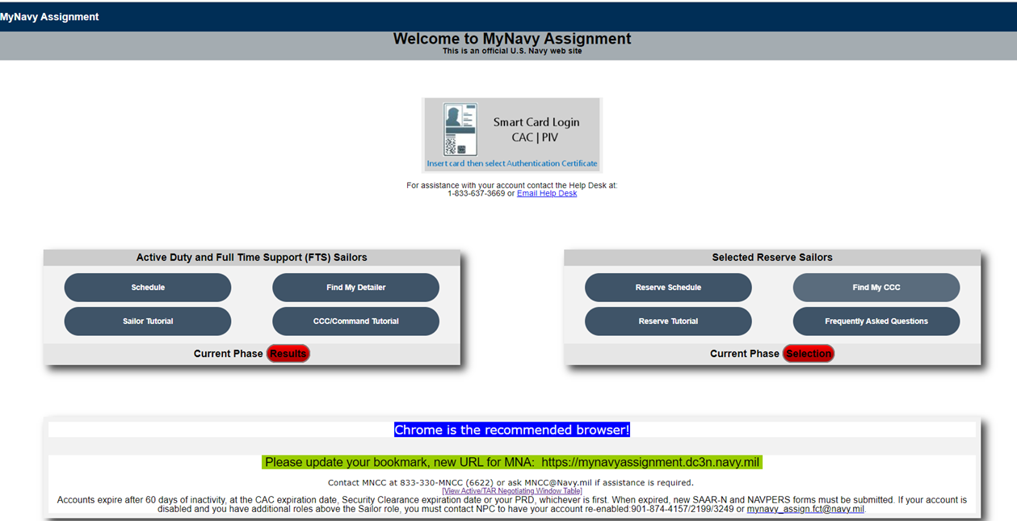
MyNavy Assignments (MNA)
Notes:
FACILITATOR GUIDE:
Discuss location of “View Access/TAR Negotiation window Table
Discuss location of Schedule
Discuss “Phase” cycles
Discuss and encourage Sailor Tutorial to aid in their navigation
Discuss and encourage CCC/Command Tutorial for your CDT

Slide 13
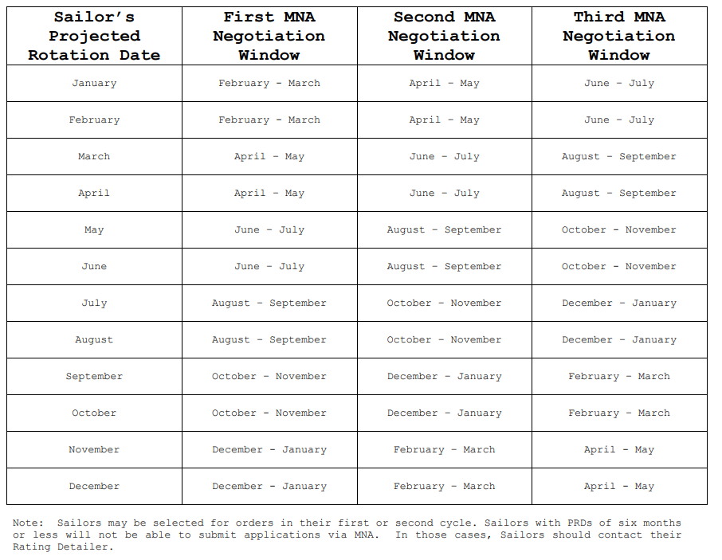
MyNavy Assignments (MNA)
Note timelines for submitting for various assignment programs:
Extension Of Enlistments
  MPM 1160-040
Sea Duty Incentive Pay (SDIP)
  POLICY DECISION MEMORANDUM (PDM) 001-21
Voluntary Sea Duty Program
  MPM 1306-141
Overseas Tour Extension Incentive Program
(OTEIP)
  MPM 1300-310
Enlisted Assignment to Special Programs
  MPM 1306-900
Notes:
FACILITATOR GUIDE:
Discuss purpose of PRD/SEAOS impact in relation to submission timelines IAW their negotiation window.
Example or Knowledge check: Which instruction provides requirements to submit a SDIP extension request for approval?

Slide 14
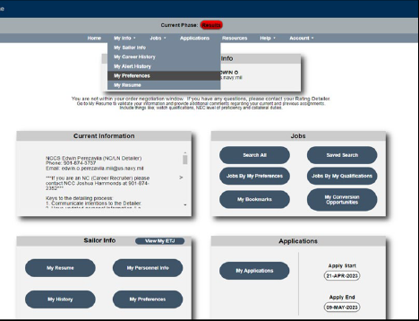
MyNavy Assignments (MNA)
Notes:
FACILITATOR GUIDE:
Recommend users complete My Preferences prior to entering negotiation window.
Discuss keeping “My Preferences” up to date at all times.
Discuss keeping “My Sailor Info” up to date at all times. Detailers can reach out to notify of new incentives and potential orders.

Slide 15
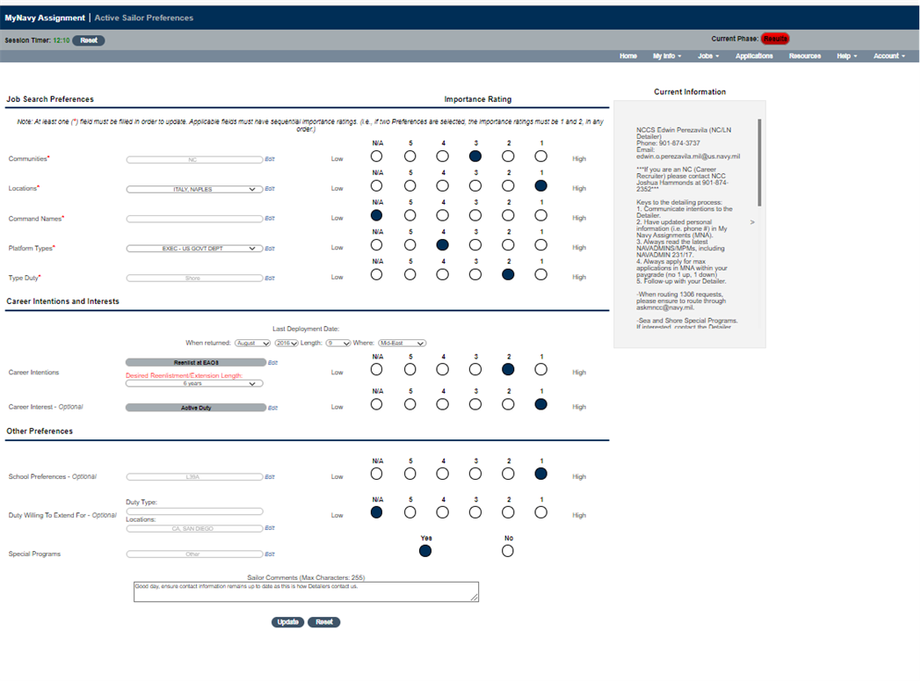
MyNavy Assignments (MNA)
Notes:
FACILITATOR GUIDE:
Discuss numerical sections must be sequential. (ex: 1, 2, 3, 4 not 1, 3, 4, 2, 5)

Slide 16
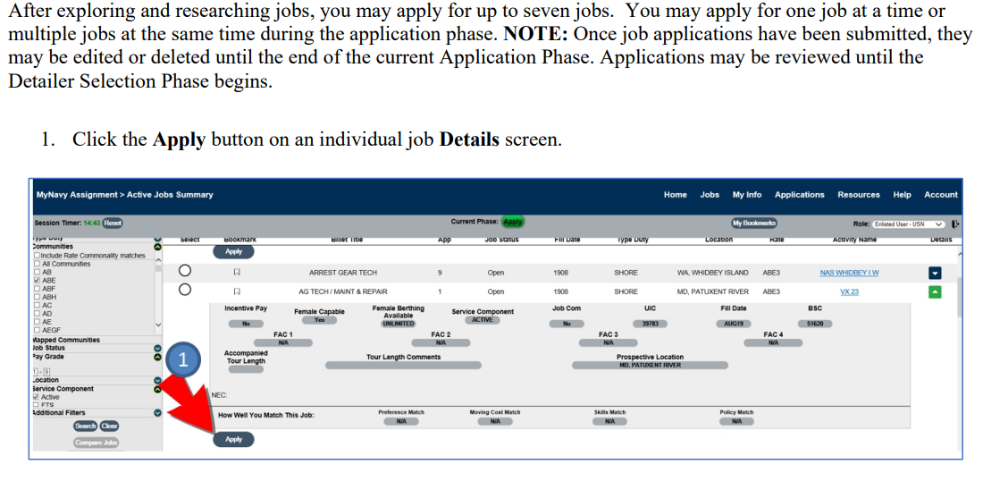
How to apply for orders in MNA
Notes:
FACILITATOR GUIDE:
Submit Applications: Displays when you are within your order detailing negotiation window and authorized to submit up to seven applications.
Applied: Displays the number of applications you have submitted up to seven.
Selected: Displays when you have been selected for a job.
Orders Under Review: Displays when you have been selected for a job and your orders are being processed.
Orders Pending Release: Your orders are waiting final release.
Orders Negotiation Window Closed: Displays “The order negotiation window has closed for this cycle” when MNA will no longer accept applications for that cycle.
Blank/Expired Projection Rotation Date: Displays “Your projected rotation date (PRD) is blank or expired. Please contact your Rating Detailer” when your PRD is blank or expired.

Slide 17
Detailing Marketplace Assignment Policy (DMAP)
Rewards Sailors in sea-intensive ratings to remain at sea.
Selected Sailors complete a 4-year Apprentice (E4 and below) sea tour followed by a 3-year Journeyman (E5) sea tour.
Incentives
  Advance-to-Position (A2P)
    *Non DMAP A2P Billets are advertised on MNA and can be identified with the indicator: "A2P"*
  Command Advance-to-Position (CA2P)
  Detailing Marketplace Incentive Pay (DMIP)
  Continuous Sea Duty Credit (CSDC)
Eligible sea intensive ratings can be found at Career-Management<Detailing<Enlisted<Detailing-Marketplace
Notes:
FACILITATOR GUIDE:
Ensure to review the current DMAP guidance prior to briefing slide to account for any changes.
DMIP: Paid monthly throughout entire 3 year Journeyman tour. $200 to $800 per month depending on location and sea duty type.
A2P: E4 eligible (PNA’d E5 exam) applies for 3 year Journeyman assignment and advances upon arrival.
CA2P: An E4 eligible (PNA’d E5 exam) Sailor is nominated by their CO to fill a vacant or soon to be vacant PO2 billet onboard the
current sea duty activity. All CA2P requests will be submitted in MNA via a Member Realignment Request (MRR). For procedural
assistance, please review the MNA User's Guide (pages 212-217), which is available under the Quick Links header.
CSDC: Adds 1 credit per month of sea duty. Resets to 0 upon transfer to shore duty. Provides priority in the detailing marketplace.
All incentives can be combined with Career Sea Pay, Sea Pay Premium and SRB.

Slide 18
Billet Based Advancement (BBA) Command Advance to Position (CA2P)
Command Advance to Position (CA2P)
  Commands/TYCOMs can submit request through MRR or Email the commands Placement Coordinator (PERS-4013).
  Applicants must have 24 months of cumulative sea duty to be eligible and PNA the last Navy-wide Advancement Exam (NWAE).
  Upon approval members are required to complete 36 months extension from the day of approval.
  TYCOMs can submit CA2P request for type 2,3,4 commands within their AOR.
  DMAP ratings are not eligible for CA2P under NAVADMIN 111/24 and must follow guidelines identified under the DMAP CA2P.
Notes:
CA2P:
Command Advance to Position. Applicants must:
PNA last NWAE
Have 24 months cumulative seat time
Be on type 2,3,4 duty.
Submit requests to MRR or Email to PERS-4013
Required additional 36 months past the date the CA2P was approved or members PRD which ever is later.
Further Guidance:
Guidance is found on MyNavy HR on the CA2P letter that needs to be submitted to the command after approval.
NAVADMIN 111/24 for further guidance.

Slide 19
Assignment Incentive Pay (AIP)
Designed to attract qualified Sailors to certain jobs/billets that are hard to fill.
AIP must be written in the orders.
Sailors “bid” on an assignment through MNA – the “Best fit” Sailor gets the job.
AIP jobs are identified in MNA with the AIP bid amount in a drop down menu.
Paid monthly and will be taxable income.
Notes:
FACILITATOR GUIDE:
Purpose to distribute Servicemembers to historically difficult to fill billets determined by the Enlisted Distributed Division (PERS-40).
Current eligibility chart can be found on MyNavy HR<References<Pay-Benefits<AIP

Slide 20
Electronic Personnel Action Request (ePAR/1306/7)
The NAVPERS 1306/7 was updated and automated to provide Sailors a standard Navy-wide format to submit requests to Assignment Control Authorities (ACAs).
Uploaded to MNCC for adjudication.
Best Practices:
  Explain to the Sailor that it is like a special request chit but the difference is that it is requesting action on behalf of the Sailor. Must be initiated by the Sailor so they understand the request they are making.
  Receive approved paper copy prior to electronic submission.
  When forwarding to MNCC via email indicate who the request should go to in the body of the email.
    Example: Forward to BUPERS 836
Notes:
FACILITATOR GUIDE:
The ePAR/1306/7 is submitted by the Sailor on MyNavy Portal (MNP), under Career Planning
The ePAR is electronically released by the CCC after it is endorsed by the CO/OIC
MyNavy Career Center (MNCC) receives the ePAR and routes to the proper ACA for disposition
When a disposition is made the Sailor and CCC will receive an email and the case status will also be updated on MNP

Slide 21
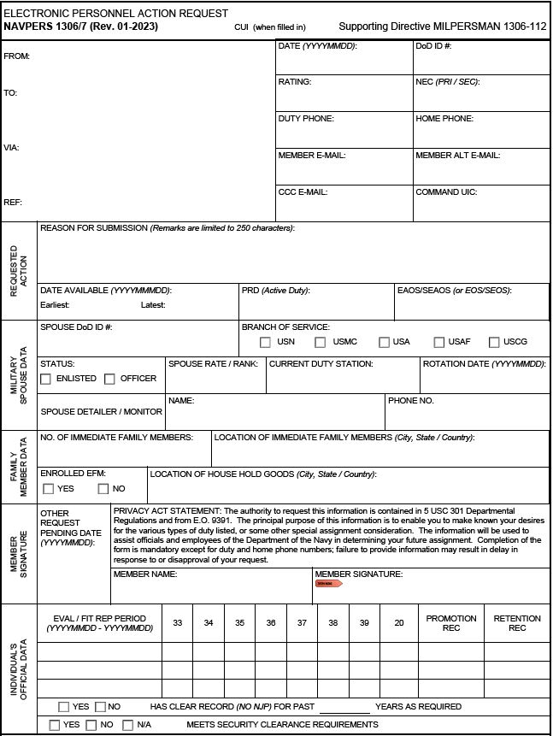
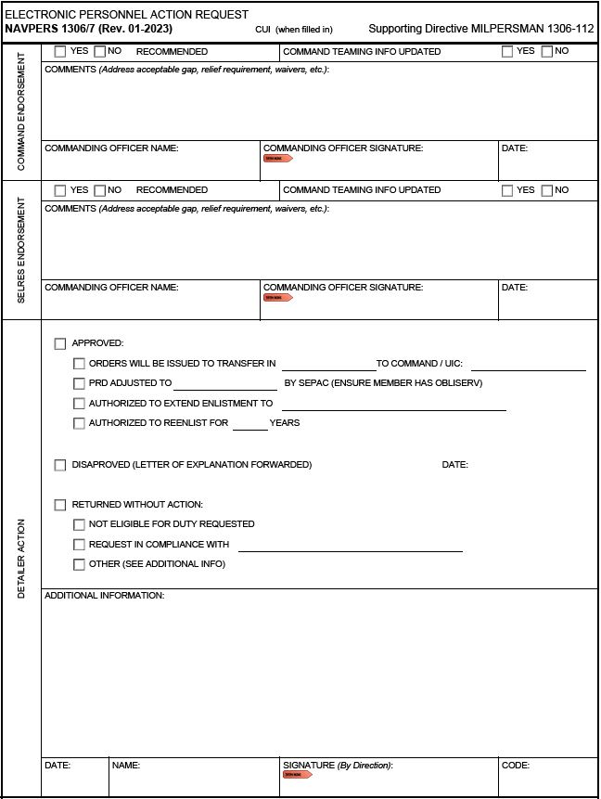

NAVPERS 1306/7
Notes:
FACILITATOR GUIDE:
Show an example of an Personnel Action Request

Slide 22
Assignment Programs
Overseas Screening
  MILPERSMAN 1300-302
Military Couple Assignment
  MILPERSMAN 1300-1000
Reassignment for Humanitarian Reasons (HUMS)
  MILPERSMAN 1300-500
Exchanges of Duty (SWAPS)
  MILPERSMAN 1306-700
Notes:
FACILITATOR GUIDE:
Example of assignment programs available.
Ensure to download applicable MPM articles and NAVADMINS for current eligibility and submission requirements.
Overseas Screening MILPERSMAN 1300-302:
Eligibility – CO has final authority
Must be interviewed to determine:
Medical and dental status
Drug and/or alcohol problems
Performance
Discipline issues
Sailor has 30 days to complete/ 60 days for dependents
Suitability/ unsuitability documented in BOL
Military Couple and Single Parent Assignment Policy, MILPERSMAN 1300-1000:
Not a guarantee
Both members must submit an endorsed ePAR/1306/7 to their detailer, only one request is required per career
Will not normally be on simultaneous sea duty unless volunteered
Sailors who apply for co-location must contact detailer directly, to apply for orders
Reassignment for Humanitarian Reasons (HUMS), MILPERSMAN 1300-500
Screening is most important element
Ensure to have supporting documents to support the request
Reason for reassignment must be resolvable within a reasonable period, normally within 6 to 12 months
Exchanges of Duty (SWAPS), MILPERSMAN 1306-700
Requirements:
Twelve months onboard at time of exchange of duty
Must not be in receipt of PCS orders
Must be same rate, rating, type duty classification code/NEC
Must have sufficient time remaining to provide 12 months at receiving command/ NUC 24
Must receive permission from both Cos
Sailors can search and post SWAPS listing on MNP
Career & Live Events/ Assignment, Leave, Travel/ SWAPS
Submit via ePAR to PERS-4, Enlisted detailer

Slide 23
Summary and Review
In this lesson we discussed:
  Enlisted Assignment System
  Types of duty Assignments
  Differences between Detailers and Placement
  Assignment incentives
  Common terms: PRD, TOS, and Obligated Service (OBLISERV)
  Matching Service Member’s needs with their duty preferences
  Electronic Personnel Action Request (ePAR 1306/7)

Slide 24

Enlisted Assignment System

